Slide 1
Battles of the American Revolution
The 13 Colonies Fight For Freedom

Slide 2
The Battle of Lexington and Concord
On the evening of April 18th, 1775 the British troops were ferried across the Boston Harbor to start their march on Lexington.
Paul Revere hung two lanterns in the church steeple. Then Paul Revere, William Dawes and Dr. Samuel Prescott rode to warn the colonists that the British were coming.
Paul Revere rode to Lexington and alerted Samuel Adams and John Hancock.
The colonists had organized a group of militia, called the Minutemen, who were in Lexington to meet the British. The Minutemen were greatly outnumbered. The British soldiers fired, killing 8 Minutemen and injuring 10 others.
Although Paul Revere was captured by British scouts before reaching Concord, other messengers managed to get through and warn the people.
While the British soldiers continued on their way to Concord, the men and women of Concord were busy moving the arms and ammunition to new hiding places in surrounding towns. When the soldiers arrived they were only able to destroy part of the supplies.
A large force of patriots gathered in response to the British troops. As the British soldiers headed back to Boston, they were attacked by the Minutemen with guerrilla warfare. All along the route, Minutemen, local farmers and townspeople continued the attack against the British. By the time the soldiers reached Boston, 73 British solders were dead and 174 more were wounded. In the days fighting, 49 patriots were killed, and 39 more were wounded.

Slide 3
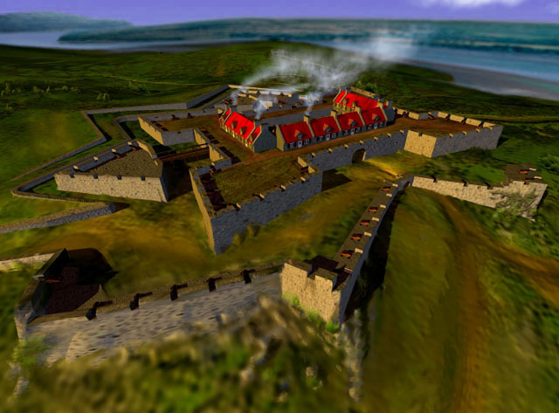
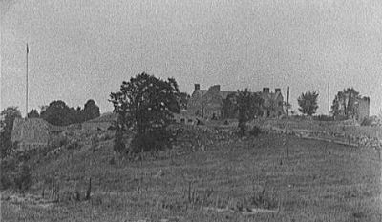
Fort Ticonderoga
Fort Ticonderoga was held by the British following battles of the French and Indian War. It was located in New York, on the shore of Lake Champlain.
In May 10, 1775, Ethan Allen and Captain Benedict Arnold of the Connecticut militia led the Green Mountain Boys of Vermont on a raid of Fort Ticonderoga.
The Americans stormed the Fort at dawn while the British troops were still sleeping. They captured the Fort without a single shot being fired. In capturing the Fort, the Green Mountain Boys captured 78 pieces of heavy artillery including 59 cannons. These cannons were later moved to Boston and played a major role in driving the British out of Boston.
The colonists suffered no casualties, and the 50 British soldiers were taken prisoner.

Slide 4
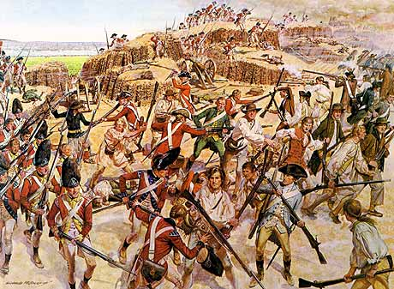
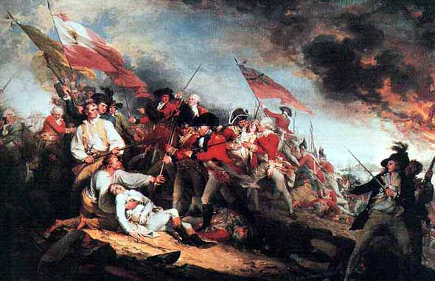
Bunker Hill
Date: June 17, 1775 Location: Boston, Massachusetts Victor: Maj. General William Howe Defeated: General Israel Putnam
Following the skirmishes at Lexington and Concord on April 19, 1775, militia had surrounded Boston, pinning the British in. Lt. General Thomas Gage that knew he was surrounded on land, so he had to control Dorchester Heights and Charlestown to keep the harbor open to British ships. The Americans were able to occupy the Charlestown peninsula before the British. On June 15, ramparts were ordered to be built on Bunker Hill. By the morning of June 17, extensive fortifications had been built on Breed's Hill.
Lt. General Gage ordered British ships to bombard the hill, while Maj. General William Howe prepared to sail across the bay and retake the position that afternoon. At three o'clock in the afternoon, the British finally began an assault on the hill. The Americans repulsed them twice, but due to dwindling ammunition, they were forced to abandon the position during the third British assault. Though the British technically won, it was at a high cost and Lt. General Gage resigned his command.

Slide 5
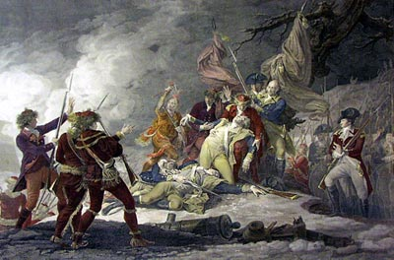
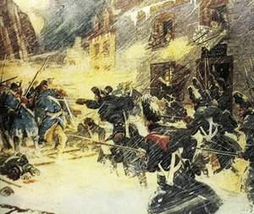
Invasion of Quebec, Canada
Date: December 31, 1775 Location: Quebec, Canada Victor: Maj. General Guy Carleton Defeated: Maj. General Richard Montgomery Other Notables: Captain Daniel Morgan
On June 27, the Continental Congress authorized an invasion of Canada, which Brig. General Richard Montgomery received. In Massachusetts on September 13, Benedict Arnold set out for Canada in command of 1,000 volunteers including Captain Daniel Morgan. Arnold planned to march up through Maine into Canada. The route turned out to be very difficult for the poorly supplied force with many portages to navigate, snowstorms and illness. General Montgomery and Arnold chose to attack under cover of storm on December 30. They attacked from two locations, but within a few minutes Montgomery was dead and Arnold was wounded. Captain Morgan took over for Arnold and led his men into the city. When they reached rendezvous, they waited for Montgomery. This indecision allowed the British time to regroup and drive the Americans back out of the city. Eventually, Morgan and his men were forced to surrender.

Slide 6
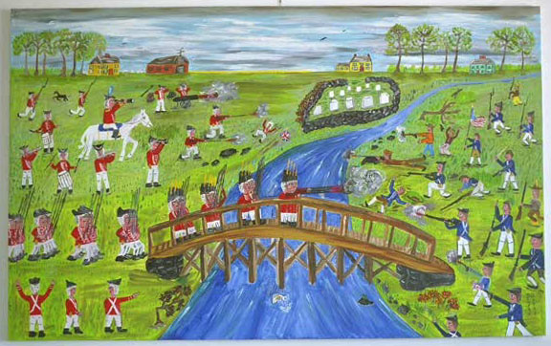
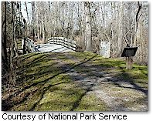
The Battle of Moore’s Creek Bridge—North Carolina
Date: February 27, 1776 Location: Moore's Creek Bridge, North Carolina Victor: Colonel James Moore Defeated: Lt. Colonel Donald McLeod
Summary In early 1776, Maj. General William Howe ordered Maj. General Henry Clinton to sail south as part of a campaign to capture the port city of Charleston and gather the support of Southern Tories. As part of the plan, Tories were to join General Clinton at Cape Fear, North Carolina. On February 20, 1776, 1,600 Scottish Highlanders set out for Cape Fear. On February 26, they learned that 1,000 Rebels were waiting with two cannon at Moore's Creek Bridge
After a council of war, the Highlanders decided to fight. They walked right into a trap and got obliterated by the Rebels. General Clinton would arrive at Cape Fear to find no Tories waiting for him. The defeat had cowed other Tories from joining the fight as well…the colonials WON!

Slide 7
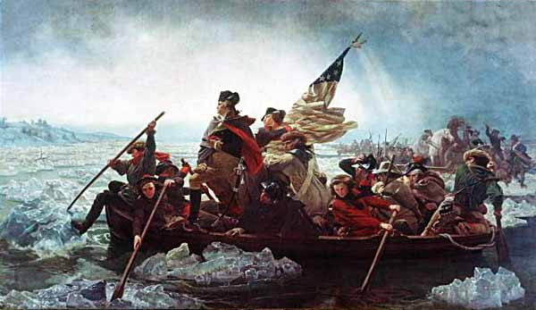
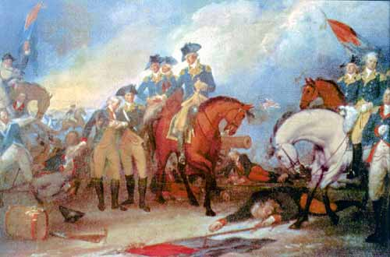
The Battle of Trenton—Washington Crosses the Delaware
Location: Trenton, New Jersey Victor: General George Washington Defeated: Colonel Johann Rall Other Notables: Maj. General Nathanael Greene
During the Fall of 1776, General George Washington had been on the retreat. Starting in August, Maj. General William Howe drove Washington first from New York City and then from New York. state. Lt. General Charles Cornwallis had then taken up the chase and sent Washington retreating across New Jersey so that in early December, Washington had crossed the Delaware River into Pennsylvania. Morale was down because the Continental Army had yet to secure a victory on the battlefield against British Army regulars. There were those in the Continental Congress who were beginning to doubt the ability of the Commander-in-Chief as well. His enlistments were running out at the end of the year and the weather was growing harsh so that he would soon have to enter winter quarters.

Slide 8
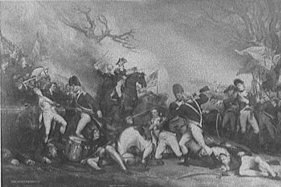
The Battle of Trenton—Princeton
Washington chose to attack the remote Hessian garrison at Trenton commanded by Colonel Johann Rall. On Christmas Night, 1776, what has been immortalized as 'The Crossing' took place in a snowstorm as Washington led his troops across the Delaware River and on to Trenton.
The rough weather had delayed General Washington's attack until 8:00 A.M., but the Hessian garrison were still recovering from the late night Christmas celebrations. The two columns of Washington's force led by Maj. General Nathanael Greene and Maj. General John Sullivan quickly overran outposts on the north and west of Trenton. They split the Hessian regiments and without taking more than a handful of casualties. They were cornered and forced to surrender in Trenton. Washington secured the victory and momentum he had so desperately needed. He was even able to press on and only a few days later, score another victory at Princeton before entering winter quarters.

Slide 9
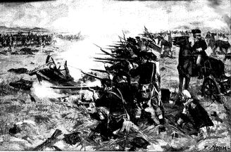
The Battles Leading to Saratoga—The Battle of Brandywine
The Battle of Brandywine was a battle of the American Revolutionary War fought on September 11, 1777. The battle was a major victory for the British and enabled them to capture the city of Philadelphia.
September 11 began with a heavy fog, which provided cover for the British troops. Washington received contradictory reports about the British troop movements and continued to believe that the main force was moving to attack at Chadds Ford. By the time the British appeared on the right flank of the Americans, it was too late to reposition and the defeated Americans were forced to retreat to Chester.
The battle cost the British about 89 killed and 487 wounded, while they claimed to have killed 200 Colonials, wounded 750 more, and captured over 400 as well as destroying or capturing most of the American artillery.

Slide 10
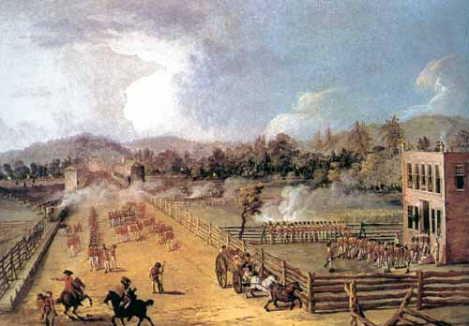
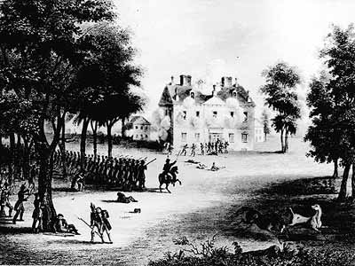
Battle of Germantown
Following the British capture of Philadelphia after the Battle of Brandywine, Howe’s troops encamped in Germantown.
Washington planned a surprise attack on October 4, 1777 with 4 separate regiments attacking Germantown at precisely 5:00 with only bayonette’s, no firing, for surprise. Although Washington’s men fought valiantly, and even broke down British forces in several areas, the colonial army was forced to retreat.
Germantown was a profound influence in convincing the French that the American cause was worth supporting by a declaration of war on England. The French were more impressed by the ability of the Americans to raise their army and deliver an attack on the British than by its lack of success.

Slide 11
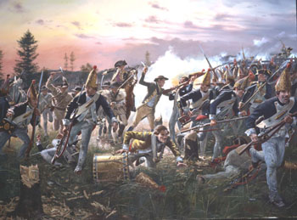
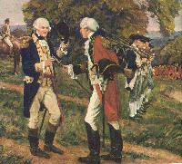
The Battle of Saratoga—The Turning Point
Location: Saratoga, New York Victor: Maj. General Horatio Gates Defeated: Maj. General John Burgoyne Other Notables: Maj. General Benjamin Lincoln, Colonel Daniel Morgan
The 2 major battles at Saratoga on September 19 and October 7, 1777.
British Major General John Burgoyne had 7500 troups that were extremely tired from being in the wilderness for 4 months with no reinforcements or supplies.
Colonial Major General Horatio Gates had a seasoned army of nearly 14,000 men, ready to fight.
Gates ordered his men to wait for attack to lure in the British. After sending a “small” force of 8,000 men on September 19…the British attacked on October 7 and were overwhelmed by the colonials. Burgoyne surrendered, and the rest of the Northern British army moved to Canada.

Slide 12
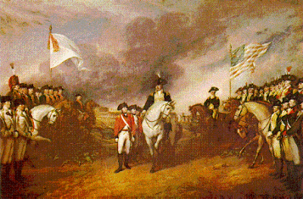
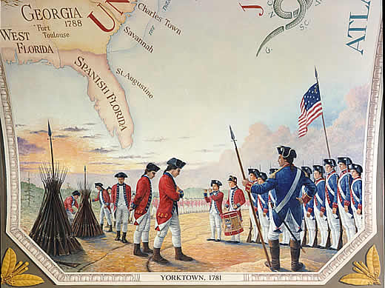
The Siege of Yorktown
Location: Yorktown, Virginia Victor: General George Washington Defeated: Lt. General Charles Cornwallis Other Notables: Maj. General Benjamin Lincoln, Lt. Colonel Banastre Tarleton
Following this was an decisive naval battle with the French navy driving off the British fleet.
Washington laid siege and began moving in feet at a time on September 17, 1781. Cornwallis was besieged by a Franco-American force of 16,000 troops. On October 9th, Washington allowed the French to begin bombarding the British Camps with their Canons. Washington, himself, fired the first shot for the Americans.
Washington attacked on October 14th, and cut off lines. Cornwallis sent message to Clinton that said, “It’s to late to save us, don’t send your men.”
On October 17th a British fleet finally set out of New York to rescue Cornwallis, but it was too late. Cornwallis was outnumbered, outgunned and was running out of food. He surrendered his army of 7,157 on October 19, 1781. THUS ENDED THE FIGHTING OF THE AMERICAN REVOLUTION!!!!

Slide 13
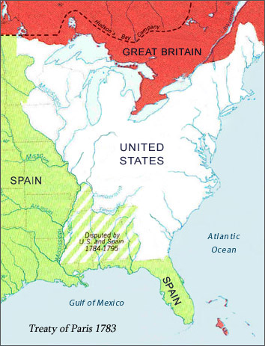
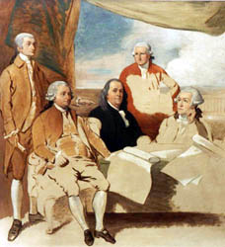
The Treaty of Paris
The Treaty of Paris was signed on September 3, 1783.
The leaders in the new country were those prominent either in the council halls or on the fields of the Revolution, and the first three Presidents after the Constitution of the United States was adopted were Washington, Adams, and Jefferson. Some of the more radical Revolutionary leaders were disappointed in the turn toward conservatism when the Revolution was over, but liberty and democracy had been fixed as the highest ideals of the United States.
The American Revolution had a great influence on liberal thought throughout Europe. The struggles and successes of the youthful democracy were much in the minds of those who brought about the French Revolution, and most assuredly later helped to inspire revolutionists in Spain's American colonies.

